Slide 1
Colorado Jamboree
“Light the Fire”
For Scouting
Sept 27-29, 2024
Cub Scout Prep Meeting
ColoradoJamboree.com

Slide 2
Agenda
Getting to Camp
Registration at Camp
Food
Questions
ColoradoJamboree.com

Slide 3
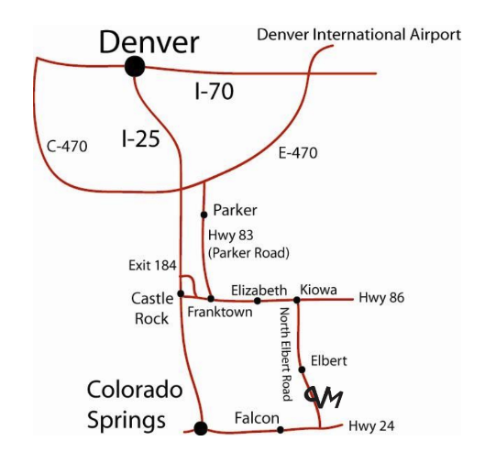
Getting to Camp
From Denver, take I-25 south to Exit 184 onto Founders Parkway near Castle Rock. Turn left at stop light to Founders Parkway. Take Founders Parkway to traffic light (Highway 86 intersection). Turn left at stop light onto Highway 86 and follow Highway 86 through Franktown and traffic signal at Parker Road.
Continue on Highway 86 through Elizabeth until you come to Elbert Highway on your right (just before the town of Kiowa). Turn on Elbert Highway and continue through the town of Elbert. Turn left (east) into Peaceful Valley Scout Ranch at the second entrance Gate 1 for Colorado Jamboree
ColoradoJamboree.com

Slide 4
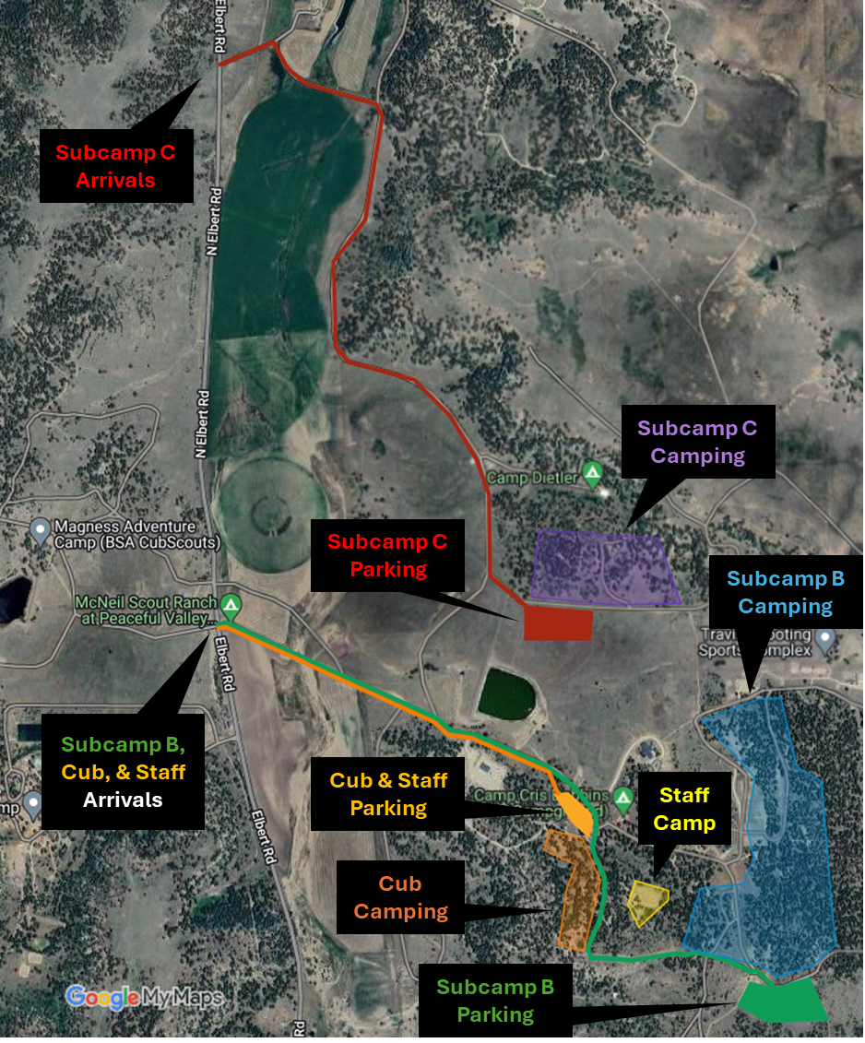
Registration
When you turn left onto camp, follow the road to Camp HQ. Volunteers will direct you to park, and once checked in at HQ, you will be told where to go for your campsite setup.
Things to bring:
Copy of your registration
Count of seatbelts in your car for emergency planning
Med form A and B for your Cub Scout
Spending cash for the trading post
ColoradoJamboree.com

Slide 5
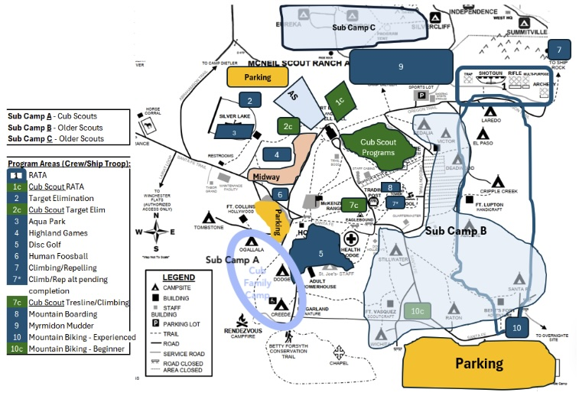
Cub Scout Camping
The area right around HQ highlighted in the light blue circle is where cub scouts are camping
ColoradoJamboree.com

Slide 6
Food
Meals for Cub Scouts
We have had some discrepancies in our registration system that has displayed conflicting information. Because of this we are doing our best to ensure everyone gets fed that needs it
Cub Scout Packs that registered as a pack are responsible for their own food
Cub Scouts that registered as a Family unit will have food available Sat Lunch, Sat Dinner, and Sun Breakfast.
Reminder – Lunch and Breakfast are grab and go meals. If you would like a heartier lunch please pack and bring that for you and your family.
Water is available all over camp
ColoradoJamboree.com

Slide 7
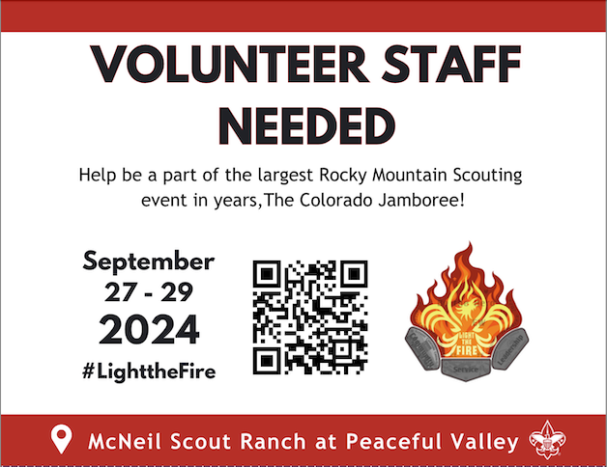
ColoradoJamboree.com

