Slide 1
Colorado Jamboree
“Light the Fire”
For Scouting
Sept 27-29, 2024
Scouts BSA, Crew, Ship, Post Prep Meeting #2
ColoradoJamboree.com

Slide 2
Agenda
Check In
Registration at your SubCamp
Check Out
Trading Post
Food Trucks
Questions
ColoradoJamboree.com

Slide 3
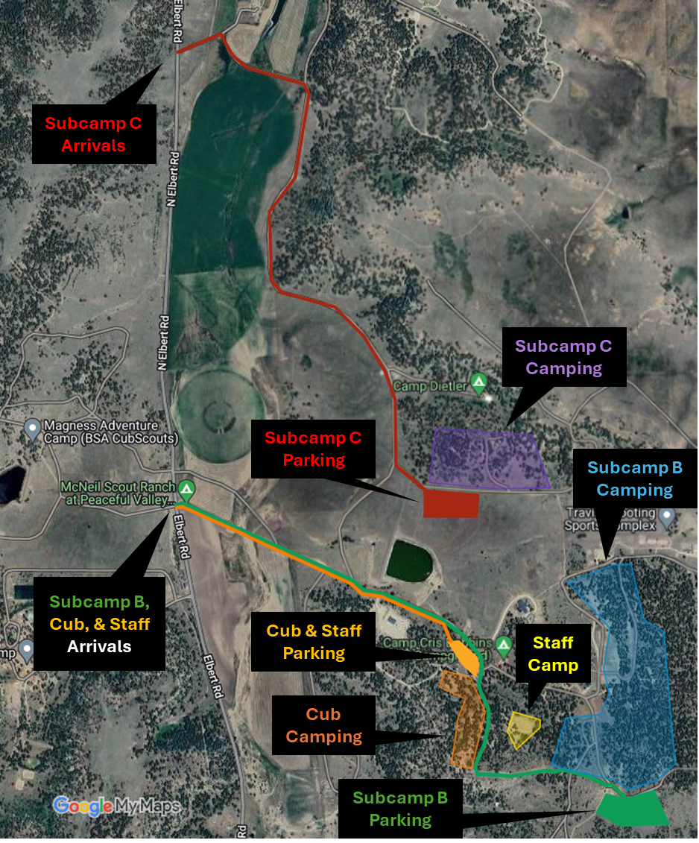
CHECK IN NEEDS
Things to bring:
Copy of your Unit Roster
Count of seatbelts in your car for emergency planning (WRITTEN ON FOLDER)
Med form A and B for your Scouts and adults on your roster
Swim Check form in your folder
Spending cash for the trading post
No permission slips needed
ColoradoJamboree.com

Slide 4
Registration at your Subcamp
Once you get to your parking area:
Follow directions to park your vehicles
Check in at the registration desk (only SM and SPL needed for this or your camping lead)
Go set up your camp
In some cases, you will be directed to another spot to park and setup camp
Your subcamp leads will let you know if you are in that list, and we will try to communicate those variables either at trailer drop off or via email ahead of the event
ColoradoJamboree.com

Slide 5
CHECK OUT PROCESS
On Sunday:
Once you are fully packed up
Campsite has been swept for all trash
Send someone to the registration folks to get checked out
All non trailered vehicles can leave asap once cleared
If the vehicle pulling the trailer is there, please wait for the subcamp team to permit you to go hook up and remove the trailer
REMINDER – road safety is priority #1!
Please wait for direction to load and leave
ColoradoJamboree.com

Slide 6
Trading Post
There will be limited amounts of:
Patch sets
Shirts
And other swag
We CAN offer a preorder process for other gear if you would like that?
Essentially, we take an order and down payment and then have the items available for pick up at Scout HQ when they arrive.
Food trucks
There will be a limited number of food trucks on camp:
It is fun to go buy some yummy snacks while doing the Jamboree so encourage some spending cash for the youth
I would not rely on these food trucks as meal replacement options
ColoradoJamboree.com

Slide 7
ColoradoJamboree.com

