Slide 1
Colorado Jamboree
“Light the Fire”
For Scouting
Sept 27-29, 2024
Scouts BSA, Crew, Ship, Post Prep Meeting
ColoradoJamboree.com

Slide 2
Agenda
Getting to Camp
Registration at your SubCamp
Trailer Drop off Process
Setup
Unit Leader Opening Meeting
Questions
ColoradoJamboree.com

Slide 3
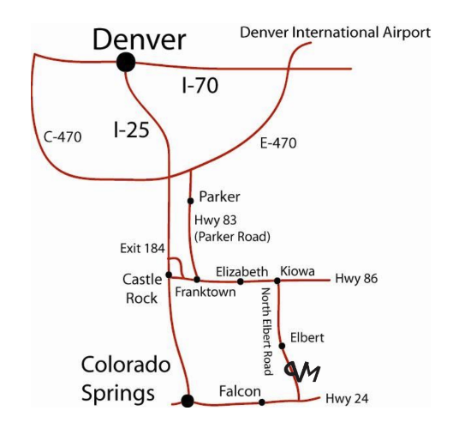
Getting to Camp
From Denver, take I-25 south to Exit 184 onto Founders Parkway near Castle Rock. Turn left at stop light to Founders Parkway. Take Founders Parkway to traffic light (Highway 86 intersection). Turn left at stop light onto Highway 86 and follow Highway 86 through Franktown and traffic signal at Parker Road.
Continue on Highway 86 through Elizabeth until you come to Elbert Highway on your right (just before the town of Kiowa). Turn on Elbert Highway and continue through the town of Elbert. Turn left (east) into Peaceful Valley Scout at either the gate near the ranch house or the gate for Camp
ColoradoJamboree.com

Slide 4
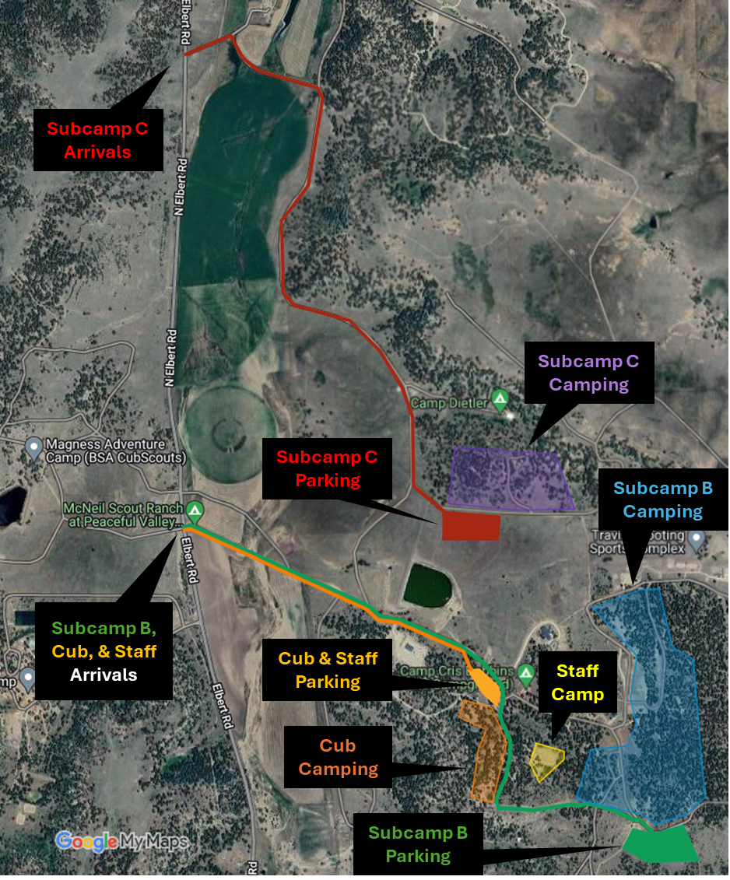
Registration
When you turn left onto camp, There will be volunteers in place to check for your subcamp placard – please have it in your window
2 ways to enter camp!
Things to bring:
Copy of your Unit Roster
Count of seatbelts in your car for emergency planning
Med form A and B for your Scouts
Swim Check form in your folder
Spending cash for the trading post
ColoradoJamboree.com

Slide 5
Trailer Drop Off
An email will go out with a sign up link for all registered unit leaders to pick a timeslot for trailer drop off
There will be a small group of volunteers on hand to support this effort so please be patient
This will also show you where your camp site area will be located
1 note: The leader guide has come out, but based on registrations, we may make changes to your subcamp assignment. You will be notified if you are impacted by this
ColoradoJamboree.com

Slide 6
Camp Setup
When you arrive at camp you will be directed to the designated parking area for your subcamp.
There are no exceptions to this
Once parked, you will be directed to the registration tent, while the unit leader is finalizing registration, the rest of the unit can begin camp setup if you know where your site is
Some units will not know that location and will need to wait for direction from the registration team
ColoradoJamboree.com

Slide 7
Unit Leaders meeting – Youth and Adult
At 9:30 PM on Fri night we will have a brief unit leader meeting below the dining hall in Gilwell
We will make any announcements needed for the following days events
Cracker Barrel will be served at this meeting
It will be brief but feel free to hang out and chat if you want! We would love to spend some fellowship time with you all!
This is a good place to bring your questions. We will have a concierge desk there for any information needs you may have so we can keep the meeting brief and on track
ColoradoJamboree.com

Slide 8
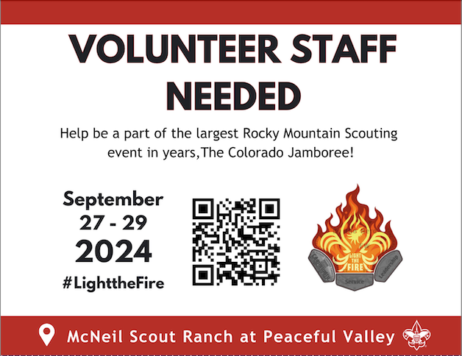
ColoradoJamboree.com

