Slide 1
Colorado Jamboree
“Light the Fire”
For Scouting
Sept 27-29, 2024
Cub Scout Preparation meeting on May 22, 2024 at 7 PM
ColoradoJamboree.com

Slide 2
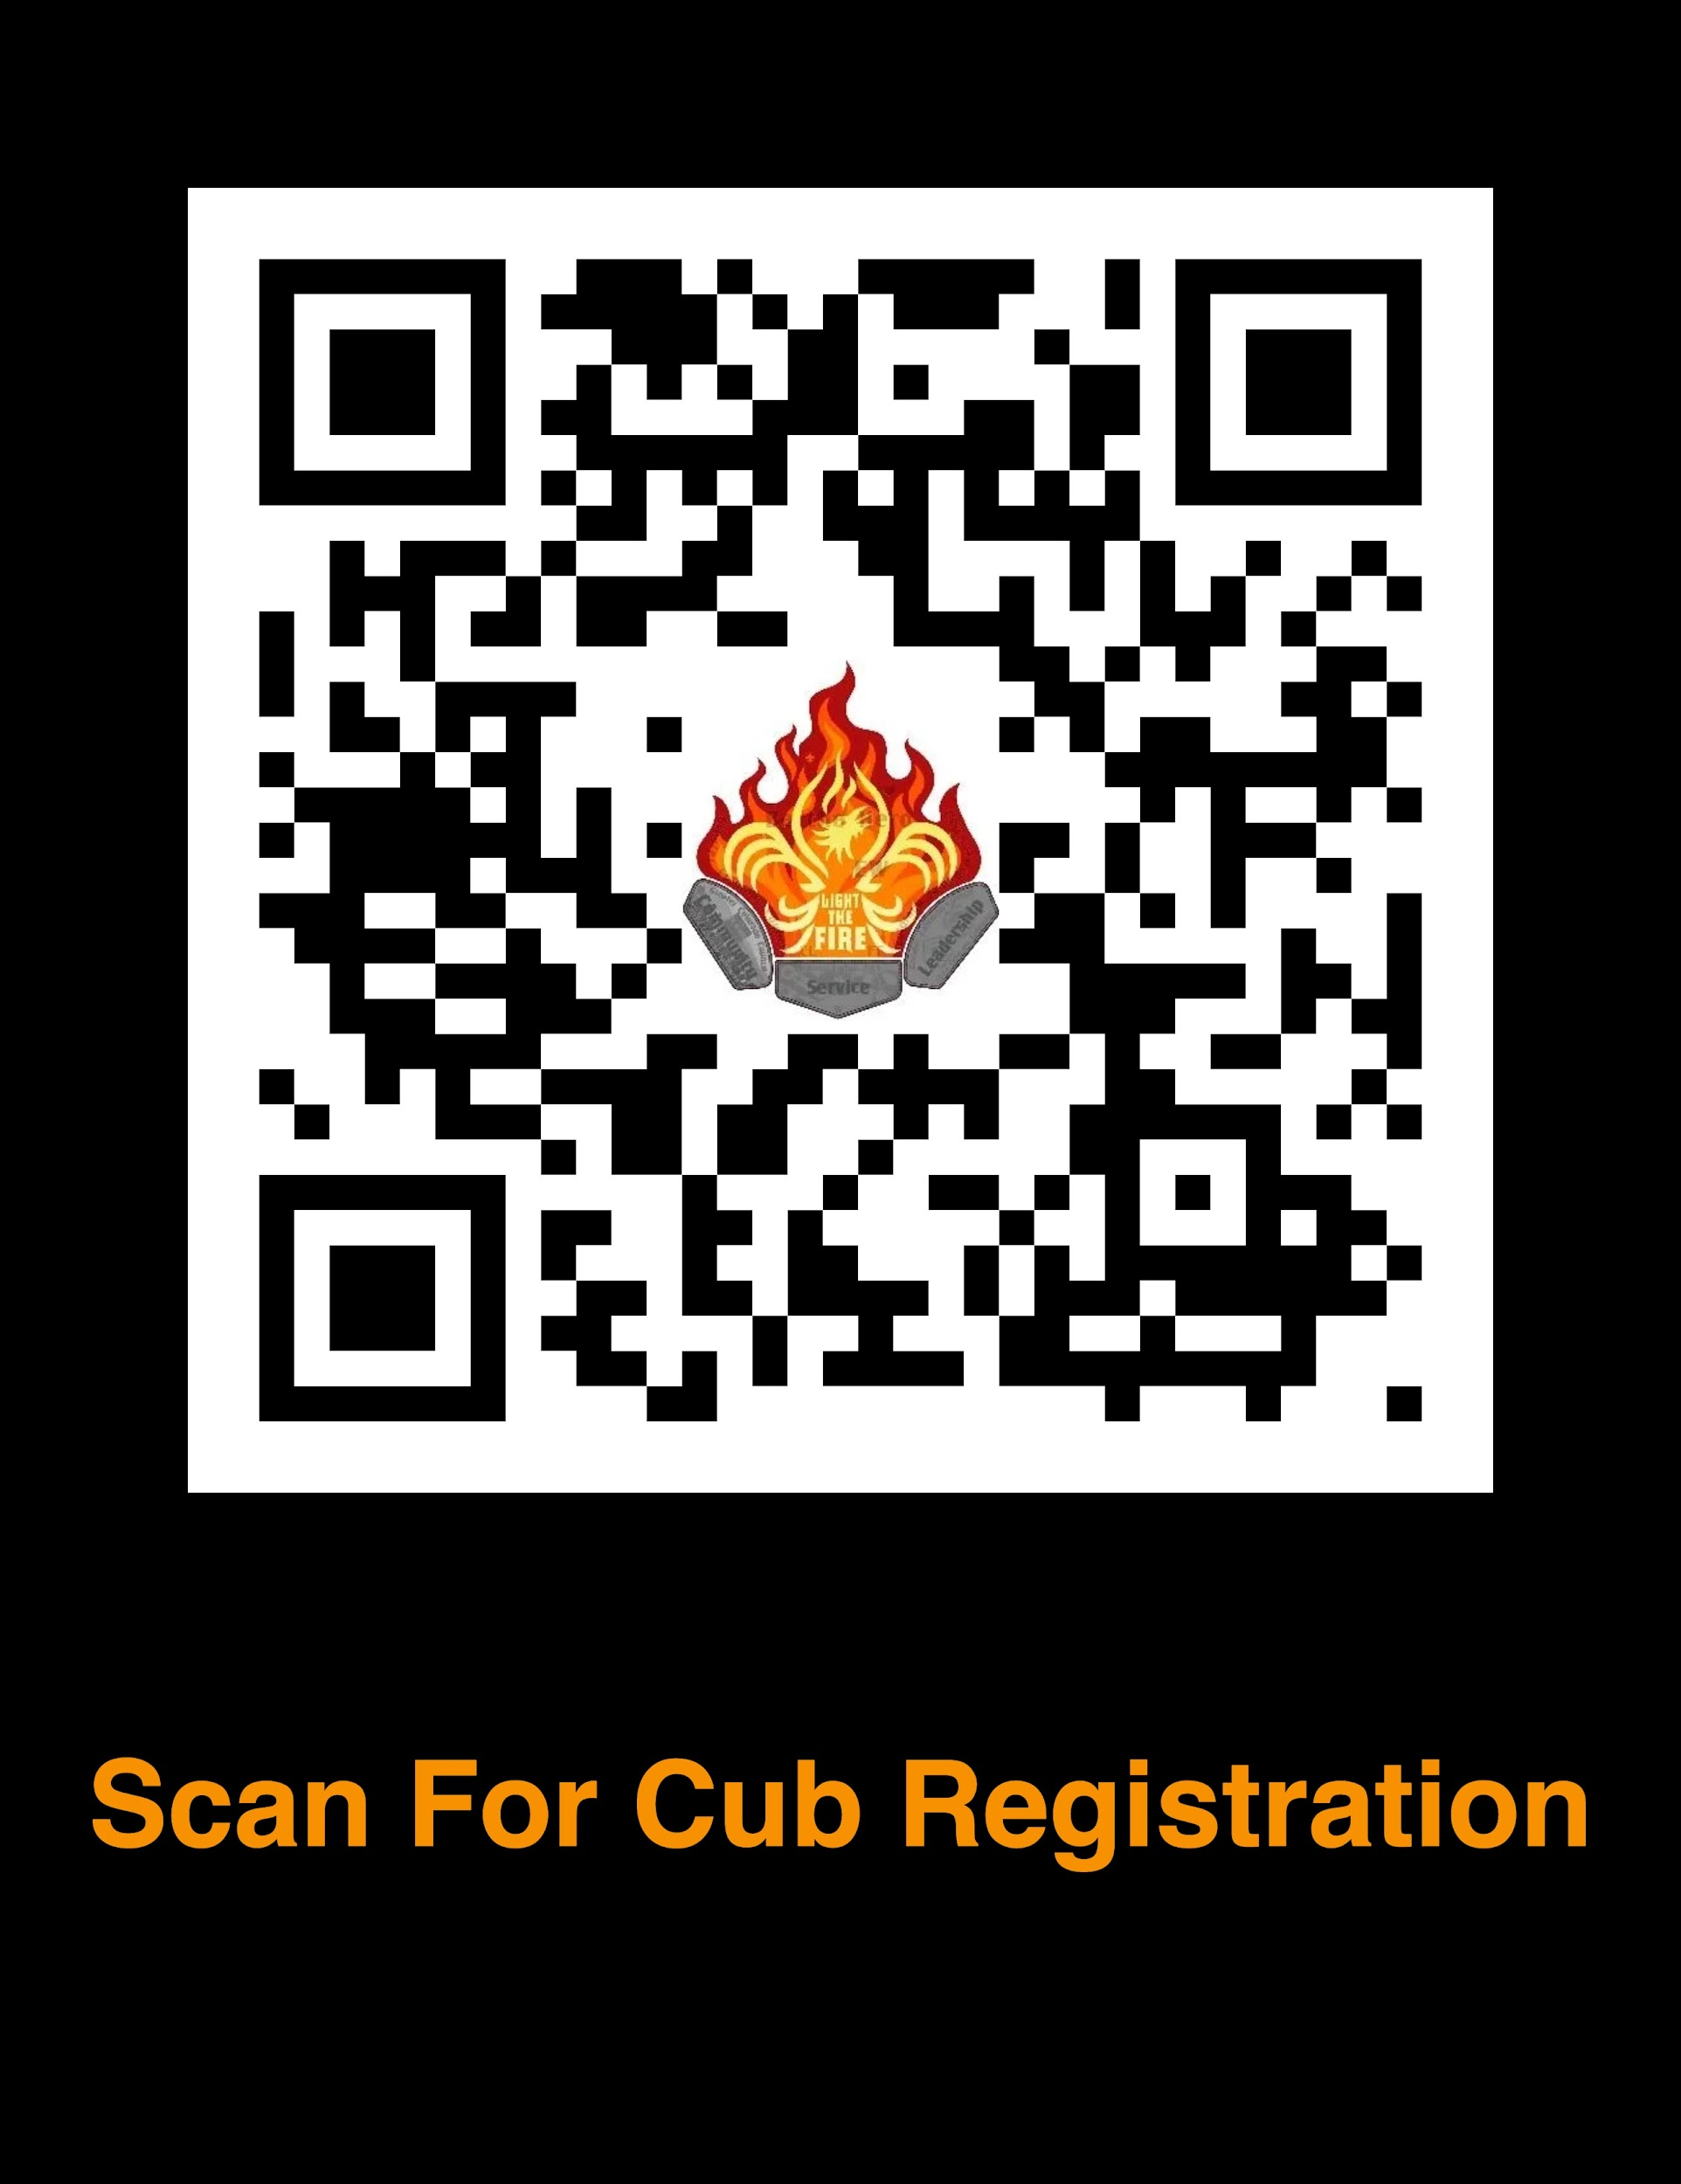
Cub Scout Information
Summary
Registration/Fees
Check in/Out
Program
Draft Schedule
Draft map
Dining and Food Service Options
Action Items & Timeline
Paperwork Checklist
What to Bring
ColoradoJamboree.com

Slide 3
Summary
We're very excited to have Cub Scouts a part of this event. The following will give you information that you need for your pack to plan ahead and ensure everyone has a fun and safe experience at the next Colorado Jamboree.
Remember there are NO EXCEPTIONS to the following:
ALL Adults staying overnight must be registered with BSA and have current YPT before coming to camp, unless they are parents camping with their own child.
ALL participants must have a medical form turned into the Jamboree Sub Camp HQ
Turn in roster of attendees and medical forms when checking in at HQ
All people attending must pay the registration fee
ColoradoJamboree.com

Slide 4
Cub Scout Registration & Fees
Colorado Jamboree is open to Cub Scout Packs and families. Reserve your space today with a $10 deposit (non-refundable but applied to your registration), give us an estimated headcount of youth and adults, and finalize and pay the balance later.
Youth Registration Fee includes t-shirt, patch, and access to program areas (per Cub Scout/Non-Scout Youth):
Day Only option (Saturday) $40 PLAN TO PACK A SACK LUNCH AND DINNER
Overnight option (Saturday - Sunday) $65 (Includes Sat Dinner, and Sun Breakfast)
Parent/Guardian/Chaperone/Pack Leader Registration Fee does NOT include t-shirt, patch, or program participation (per adult)*:
Day Only option (Saturday) $15 PLAN TO PACK A SACK LUNCH AND DINNER
Overnight option (Saturday - Sunday) $25 (Includes Sat Dinner, and Sun Breakfast)
*T-Shirts and patches can be purchased separately through the Colorado Jamboree website
ColoradoJamboree.com

Slide 5
Cub Scout Registration & Fees
Registration fees are non-refundable but transferable. Once the unit is registered additional participants' fees will be the same as those previously registered.
Registration for the Cub Scouts attending w/ their parents will be similar to what the Council Does for the “Cub Scout Fall Camping Weekends”
The registration will require a parent or guardian to register with their Cub Scout attending Camp. This will apply for all ranks of the Cub Scout program.
ALL ADULT LEADERS STAYING OVERNIGHT MUST BE REGISTERED WITH BSA AND HAVE CURRENT YPT CERTIFICATION. PARENTS ATTENDING WITH THEIR OWN SCOUT DO NOT HAVE TO BE REGISTERED. EVERY person attending the Jamboree must have a completed medical form. Forms used for previous District/Council events are acceptable. Be sure they are still up to date.
ColoradoJamboree.com

Slide 6
Cub Scout Check in and Check out
Day visitor Cub Scout Packs can check in starting at 7 AM Saturday morning at their Unit’s Sub Camp
The Saturday “Campfire” Arena show and live concert will conclude by 9ish PM.
For Cub Pack camping, arrival starts after 6:30 AM on Saturday and Checkout is at 10 AM on Sunday. Please coordinate with your Pack leaders for food and camp logistics.
Due to Camp regulations and the volume of traffic we create, unloading and parking can be a slow process. PLEASE, follow the directions of the traffic control people and be respectful. Units may leave 1 TRAILER at the campsite. All other vehicles are to be parked in the parking area designated for your subcamp (see map).
ColoradoJamboree.com

Slide 7
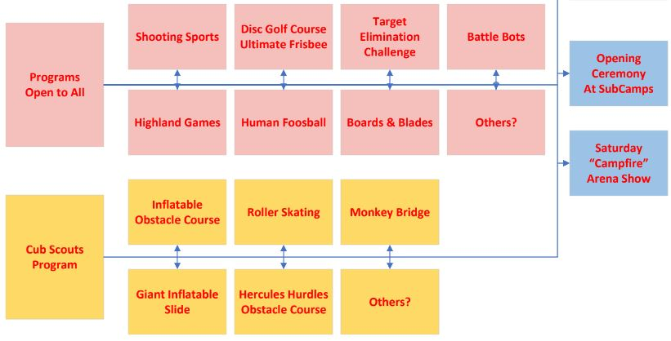
Program
ColoradoJamboree.com

Slide 8
Draft Schedule
FRIDAY
3:00 - 8:00 PM Check-in at Sub-Camp (and then set up unit camp)
9:30 PM Scoutmaster and SPL meeting/cracker barrel - Gilwell Hall Bring something to share!
10:00 PM Lights out-quiet time
SATURDAY
7:00 AM Cub Pack and Scout Troops Check-in - Registration at HQ
8:30 AM OPENING Flag Ceremony at sub-camp
9:00 AM Activities Begin
12 PM Activities close – Return to campsite for lunch
11:45 AM–1:00 PM Lunch
5 PM – 6:30 PM Activities close, Dinner
6:30 PM ARENA campfire program
SUNDAY
8:30 AM Closing Ceremony Chapel Service at sub-camp - Scout awards given at this time
10:30 AM Check out of camp, remember all trash goes home with you!
ColoradoJamboree.com

Slide 9
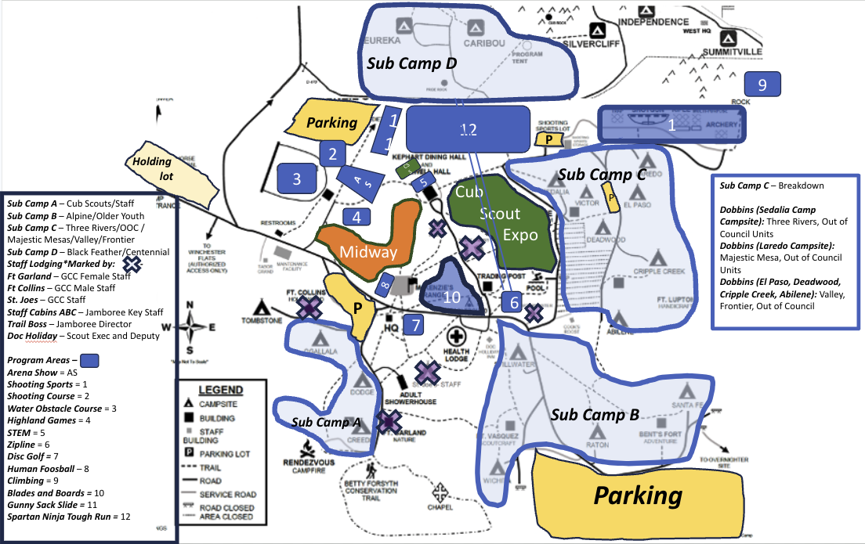
Draft Map
Sub Camp A: Ogallala, Dodge, Creede
Sub Camp B: Sedalia, Victor, Deadwood,Raton, Wichita, Stillwater
Sub Camp C: Abilene, El Paso, Cripple Creek, Victor, Loredo
Sub Camp D: Eureka, Caribou
ColoradoJamboree.com

Slide 10
Cub Scout Logistics Dining & Food Options
Day visitor Cub Scout Packs can bring their own food, prepare with their Scout Troop, or get options from Food Trucks that will be available on site.
Option 1 – Pack Registration: This option is for high functioning packs, and they will arrive Saturday morning and be given a campsite. The pack is responsible for ensuring all pack overnight camping requirements are met and must have a BALOO Trained Leader Present. The Pack is responsible for all the meals for their members meet CS Camping Requirements.
Option 2 – Individual CS Family Registrations. This option allows for individual CS and their family to participate in the CO Jamboree. The CO Jamboree will be providing Saturday Dinner and Sunday Breakfast to those registered this way..
ColoradoJamboree.com

Slide 11
Action Items
JUNE:
Leader Guide Published
AUGUST 15:
– Balance of Registration Due
Names will be loaded
SEPTEMBER:
• Audit registrations. Notify Council of any cancellations to avoid fees.
• Check completion status of medical forms in CampDoc. Contact those that are deficient.
• Inform/remind parents of medication and OTC policies.
• Audit the list of participants in CampDoc –
• Supply permission forms for those that need them. Collect completed forms to turn in on arrival.
• Supply packing lists and information to campers.
• Collect a list of those that will provide their own tents, and how many tents are needed
from the camp
ColoradoJamboree.com

Slide 12
Action Items - Continued
2 WEEKS BEFORE CAMP:
• Check completion status of medical forms in CampDoc. Contact those that are deficient.
• Notify participants in your unit on information to carpool to camp.
• Collect any remaining permission forms.
• Inform campers of camp rules and policies from Leader’s Guide.
• Inform campers of program information and activities from Program Guide and
ColoradoJamboree.com.
• Sign up all adult leaders attending camp for text-message alerts.
• Remind parents of youth medication and OTC policies.
11 DAYS BEFORE CAMP:
• All medical forms for all participants in your unit are due.
• Camp-Provided Tent Requests are due. Click here for the form.
• Attend the 11-day meeting to get last-minute information about camp.
1 WEEK BEFORE CAMP:
• Complete the Unit Check-In and Seatbelt Inventory form. Bring to camp.
DAY BEFORE CAMP:
• Ensure you have completed permission forms and Unit Check-In Roster
ColoradoJamboree.com

Slide 13
Paperwork Checklist -
Youth Camper Checklist
✓ BSA Medical Form Parts A & B
✓ Copy of Insurance Card (front and back) (Upload photo or scan to CampDoc) o For Tricare please submit a Proof of Coverage letter.
✓ Colorado Addendum: Immunizations (Print or Download, Fill Out, Scan to CampDoc) ▪ This form does not need to be signed by a doctor.
✓ Colorado Addendum: Additional Information (Built In To CampDoc)
✓ Colorado Addendum: Contract to Carry (only for youth carrying emergency meds)
✓ Special Diet Request Form – If applicable
Adult Camper Checklist
✓ BSA Medical Form Parts A & B
✓ Copy of Insurance Card (front and back) (Upload photo or scan to CampDoc)
o For Tricare please submit a Proof of Coverage letter.
✓ Youth Protection Training Certificate – Upload to CampDoc
✓ BSA Membership verification – Upload to CampDoc
✓ Special Diet Request Form – If applicable
ColoradoJamboree.com

Slide 14
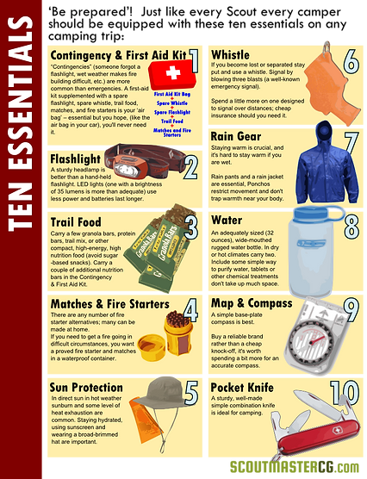
What to Bring
DO NOT BRING:
Knives, guns, nor matches/firestarter
Camp Chairs
10 Essentials
Sunscreen
Snacks
Water Bottles
Rain Gear
Day Packs
Extra Layers
ColoradoJamboree.com

Slide 15
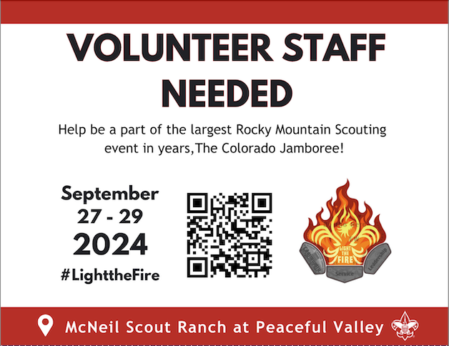
ColoradoJamboree.com

