Slide 1
Colorado Jamboree
“Light the Fire”
For Scouting
Sept 27-29, 2024
Troop, Ship, Crew, Post
Scout Preparation meeting on
May 8th, 2024 at 7 PM
ColoradoJamboree.com

Slide 2
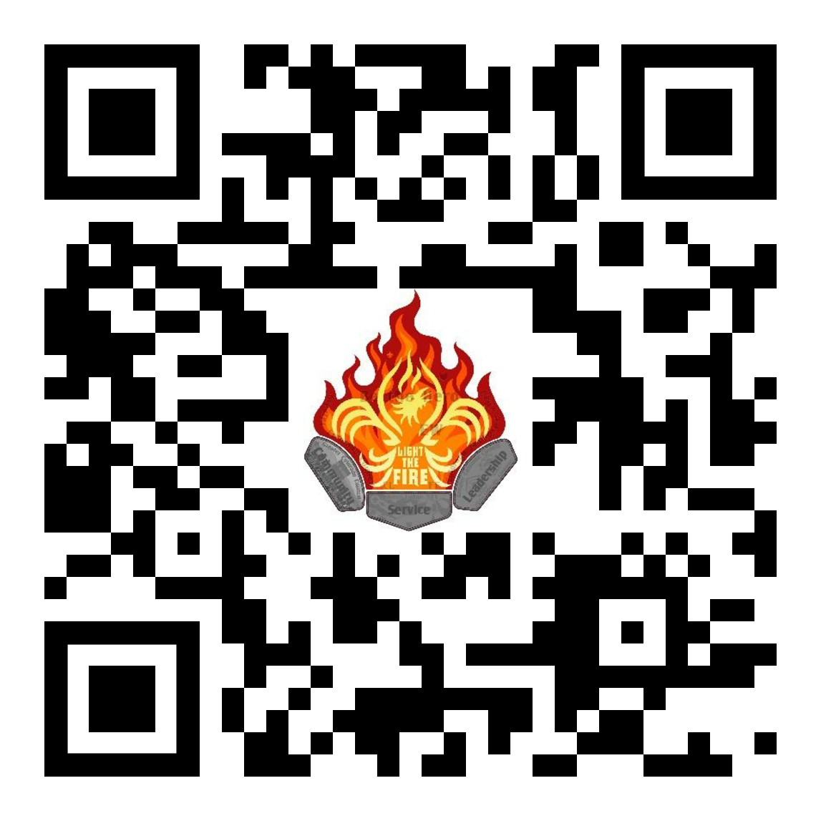
Unit Information
Summary
Registration/Fees
Check in/Out
Program
Draft Schedule
Draft map
Dining and Food Service Options
Action Items & Timeline
Paperwork Checklist
What to Bring
ColoradoJamboree.com

Slide 3
Summary
We're very excited to have all Scout units a part of this event. The following will give you information that you need for your unit to plan ahead and ensure everyone has a fun and safe experience at the next Colorado Jamboree.
Remember there are NO EXCEPTIONS to the following:
ALL Adults staying overnight must be registered with BSA and have current YPT before coming to camp
ALL participants must have a medical form turned into the Sub Camp HQ they are camping in
Turn in roster of attendees and medical forms when checking in at your subcamp HQ
All people attending must pay the registration fee
ColoradoJamboree.com

Slide 4
Scout (Troop, Crew, Post, Ship) Registration & Fees
Colorado Jamboree is open to all types of units. Reserve your space today with a $10 deposit (non-refundable but applied to your registration), give us an estimated headcount of youth and adults, and finalize and pay the balance later.
$75/participant
Additional programming for all units
See next slide for in depth info
Ability to buy clothing, backpacks and extra patch sets!
We will have options for extra swag, clothing and patch set purchases through sign up links and the program itself,
ALL ADULT LEADERS STAYING OVERNIGHT MUST BE REGISTERED WITH BSA AND HAVE CURRENT YPT CERTIFICATION. EVERY person attending the Jamboree must have a completed medical form. Forms used for previous District/Council events are acceptable. Be sure they are still up to date.
ColoradoJamboree.com

Slide 5
Scout (Troop, Crew, Post, Ship) Registration & Fees
OPTIONAL ADD-ONS
Available options for Troop, Ship, Post, or Crew Unit Registrations only:
Powder Horn (Open to both registered adults and youth who are at least 13 and have completed the 8th grade. Powder Horn is a hands-on resource management course designed to give you the contacts and tools necessary to conduct an awesome high-adventure program in your troop, team, crew, or ship.)
Troop/Crew/Ship Youth and all Adults $10/participant
With Paid ($4 per youth) Early Arrival or Late Departure, per youth participant
Friday Zipline (175 participant limit) $3/per YOUTH
Friday Shooting Sports (300 participant limit) $3/per YOUTH
Friday Zipline and Shooting Sports Combo (125 participant limit) $6/per YOUTH
Sunday Zipline (150 participant limit) $3/per YOUTH
Sunday Shooting Sports (275 participant limit) $3/per YOUTH
Sunday Zipline and Shooting Sports Combo (100 participant limit) $6/per YOUTH
ColoradoJamboree.com

Slide 6
Unit Check in and Check out
For local units camping with standard registration, arrival starts after 3PM on Friday with check in starting at 5PM and Checkout is at 10 AM on Sunday. Please coordinate with your Troop leaders for food and camp logistics.
Early Arrival can check in starting at 5 PM Thurs or 7 AM Friday morning at their Unit’s Sub Camp
Late Departure on Sunday - Programming ends at 4PM and All camps must clear by 7PM
Due to Camp regulations and the volume of traffic we create, unloading and parking can be a slow process. PLEASE, follow the directions of the traffic control people and be respectful. Units may leave 1 TRAILER at the campsite. All other vehicles are to be parked in the parking area designated for your subcamp (see map).
ColoradoJamboree.com

Slide 7
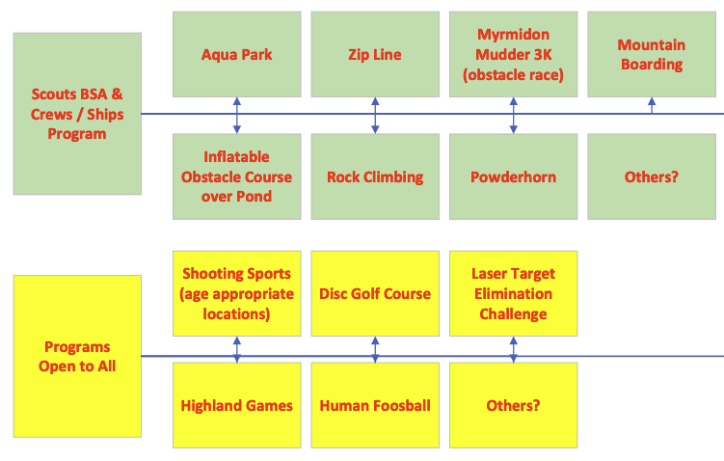
Program
ColoradoJamboree.com

Slide 8
Draft Schedule
FRIDAY
5:00 - 8:00 PM Check-in at Sub-Camp (and then set up unit camp)(Can show up as early as 3PM Fri - Trailer drop off the weekend prior is required)
9:30 PM Scoutmaster and SPL meeting/cracker barrel - Gilwell Hall Bring something to share!
10:00 PM Lights out-quiet time
SATURDAY
8:00 AM Cub Pack Check-in - Registration at HQ
8:00 AM OPENING Flag Ceremony
8:15 AM Activities Begin
12 PM Activities remain open – East your sack lunch
5 PM – 6:00 PM Activities close, Dinner at Campsite on own
7:00 PM ARENA campfire program
SUNDAY
8:30 AM Chapel Service -
9:00 AM Closing Flags
10:30 AM Check out of camp, remember all trash goes home with you!
ColoradoJamboree.com

Slide 9
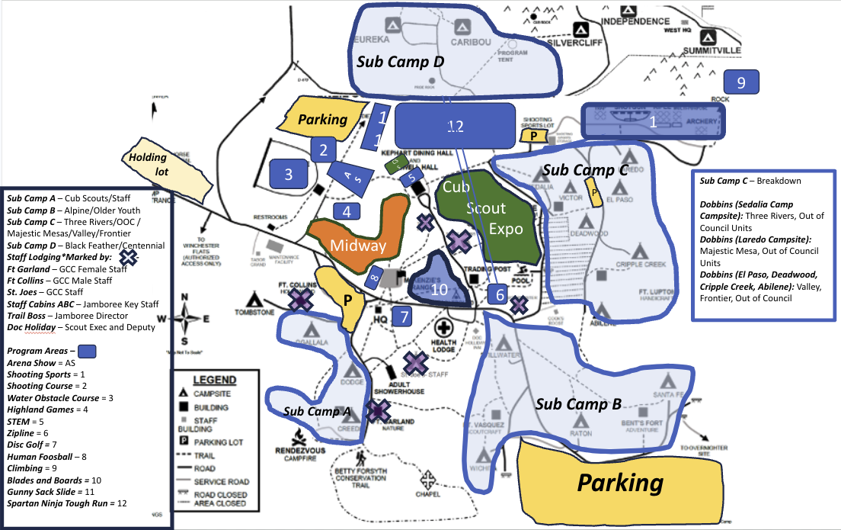
Draft Map
Sub Camp A: Ogallala, Dodge, Creede - Cub Scouts
Sub Camp B: Sedalia, Victor, Deadwood,Raton, Wichita, Stillwater - Alpine and Older Youth
Sub Camp C: Abilene, El Paso, Cripple Creek, Victor, Loredo - TR, OOC, MM, Valley, Frontier
Sub Camp D: Eureka, Caribou - Black Feather, Centennial
ColoradoJamboree.com

Slide 10
Dining & Food Options
Troops, Crews, Ships and Posts bring their own food, prepare with their Unit, or get options from Food Trucks that will be available on site…
Cub Scouts can either handle their own food as a pack or opt in to the food purchase option at additional cost - Meals provided are Saturday dinner, and grab and go breakfast Sunday
Staff eat at the dining hall - If you are a day of staffer there will be an option to opt in to eating with staff at an additional cost
There will be some food trucks and swag shopping on site for a bit of wow and out of the ordinary fun so encourage scouts to bring some spending dollars if they wish
ColoradoJamboree.com

Slide 11
Action Items
JULY:
Leader Guide Published
AUGUST 15:
– Balance of Registration Due
Names will be loaded
SEPTEMBER:
• Audit registrations. Notify Council of any cancellations to avoid fees.
Audit the list of participants in Doubleknot
• Communicate with Unit leaders via update calls about:
Check completion status of medical forms by registered unit.
Inform/remind parents of medication and OTC policies.
On site check in process - MUST HAVE THINGS READY WHEN DRIVING INTO CAMP
Supply permission forms for those that need them. Completed forms to turn in on arrival.
Supply packing lists and information to campers, via consistent and specific messaging
• If possible, complete unit swim checks at the unit level. Complete the form.
ColoradoJamboree.com

Slide 12
Action Items - Continued
2 WEEKS BEFORE CAMP:
• Check completion status of medical forms in
• Notify participants in your unit on information to carpool to camp.
• Collect any remaining permission forms.
• Inform campers of camp rules and policies from Leader’s Guide.
• Inform campers of program information and activities from Program Guide and
ColoradoJamboree.com.
• Sign up all adult leaders attending camp for text-message alerts.
• Remind parents of youth medication and OTC policies.
11 DAYS BEFORE CAMP:
• All medical forms for all participants in your unit are due.
• Attend the 11-day meeting to get last-minute information about camp.
1 WEEK BEFORE CAMP:
• Complete the Unit Check-In and Seatbelt Inventory form. Bring to camp.
DAY BEFORE CAMP:
• Ensure you have completed permission forms, Unit Check-In Roster and Swim Classification
Record (if applicable).
ColoradoJamboree.com

Slide 13
Paperwork Checklist -
Youth Camper Checklist
✓ BSA Medical Form Parts A & B (Built In To CampDoc)
✓ BSA Medical Form Part C – Physical Evaluation within 1 year (Print, Fill Out & Sign, bring to subcamp check in)
o The physical must be within one year and cannot “expire” during camp. No exceptions.
✓ Copy of Insurance Card (front and back) o For Tricare please submit a Proof of Coverage letter.
✓ Colorado Addendum: Immunizations This form does not need to be signed by a doctor.
✓ Colorado Addendum: Additional Information
✓ Colorado Addendum: Contract to Carry (only for youth carrying emergency meds)
✓ Special Diet Request Form – If applicable
Adult Camper Checklist
✓ BSA Medical Form Parts A & B
✓ BSA Medical Form Part C – Physical Evaluation within 1 year (Print, Fill Out & Sign, Bring to your subcamp)
o The physical must be within one year and cannot “expire” during camp. No exceptions.
✓ Copy of Insurance Card (front and back)
o For Tricare please submit a Proof of Coverage letter.
✓ Youth Protection Training Certificate – Upload to CampDoc
✓ BSA Membership verification – Upload to CampDoc
✓ Special Diet Request Form – If applicable
ColoradoJamboree.com

Slide 14
What to Bring
Camp Chairs
6 Essentials
Sunscreen
Snacks
Water Bottles
Rain Gear
Day Packs
Extra Layers
NO:
Fire starters
Pocket knives
ColoradoJamboree.com

Slide 15
ColoradoJamboree.com

